Slide 1
Worth The Weight
Capstone Project Pitch- Katelynn Dunn
SWDV 691 Joseph Gradecki

Slide 2

Why Create This
According to the CDC, in 2017-2018 the prevalence of obesity among U.S. adults was 42.4%. (cdc.gov)
Severe obesity can have multiple serious chronic diseases
  Increased complications of COVID (cdc.gov)
  Heart disease
  High blood pressure
  Type 2 diabetes
  Depression and anxiety

Slide 3
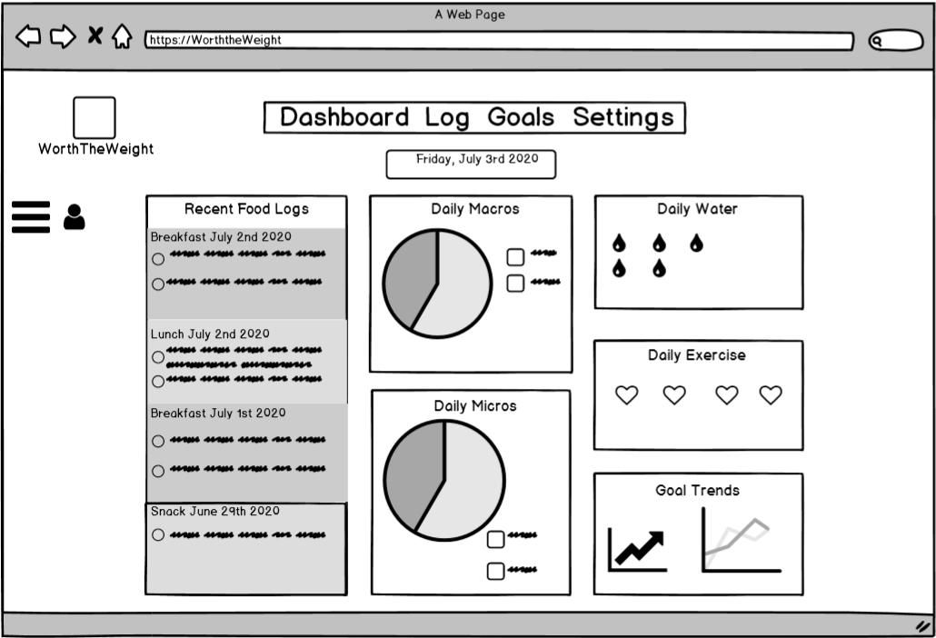
What Is It
Calorie tracking application/ weight loss application.
Allows users to track micronutrients, macronutrients, water and exercise.
Allows users to set weight loss goals.
Shows users how they are in terms of progress to their goals

Slide 4
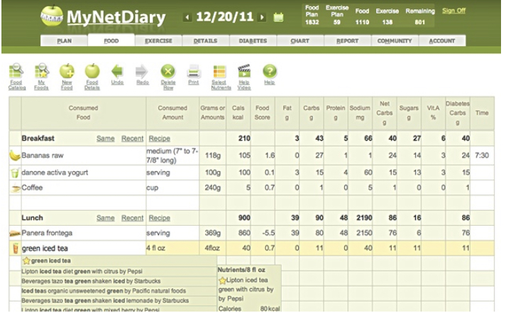
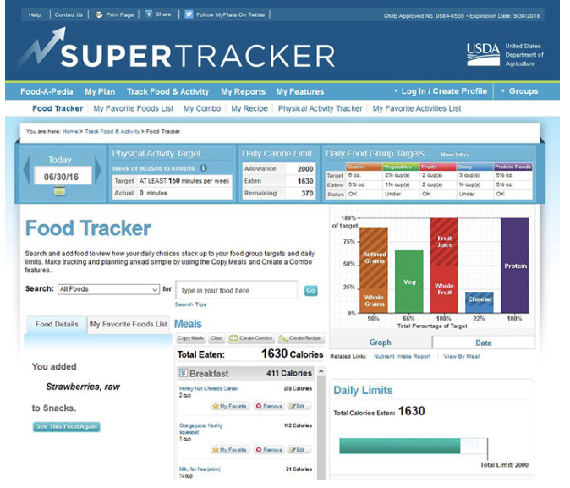
What will it solve
An easy to use, intuitive interface for non technical users.
Ability to log macronutrients, micronutrients, water and exercise all in one application

Slide 5

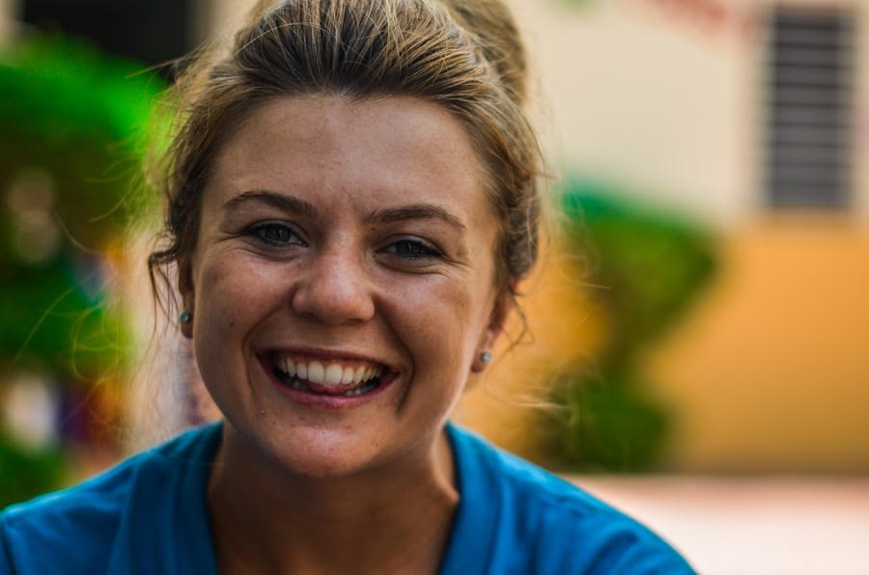
Who will be Using this?
Mostly Females, some males in their 20’s and 30’s
People who have struggled with weight loss and dieting in the past.
People who have busy lives
People who have a low to middle family income
People who are not well versed in technology

Slide 6
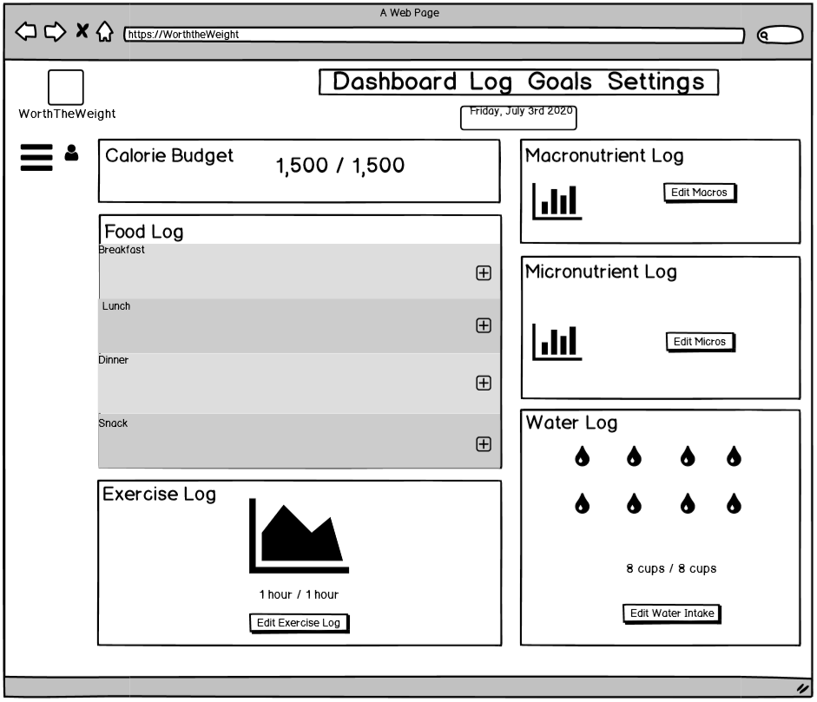
How would people use it?
Users would log into account and track their health and nutrition.
Track and edit calories, exercise, water intake, macronutrients, micronutrients
Add and edit weight loss goals

Slide 7
Thank You

